Slide 1

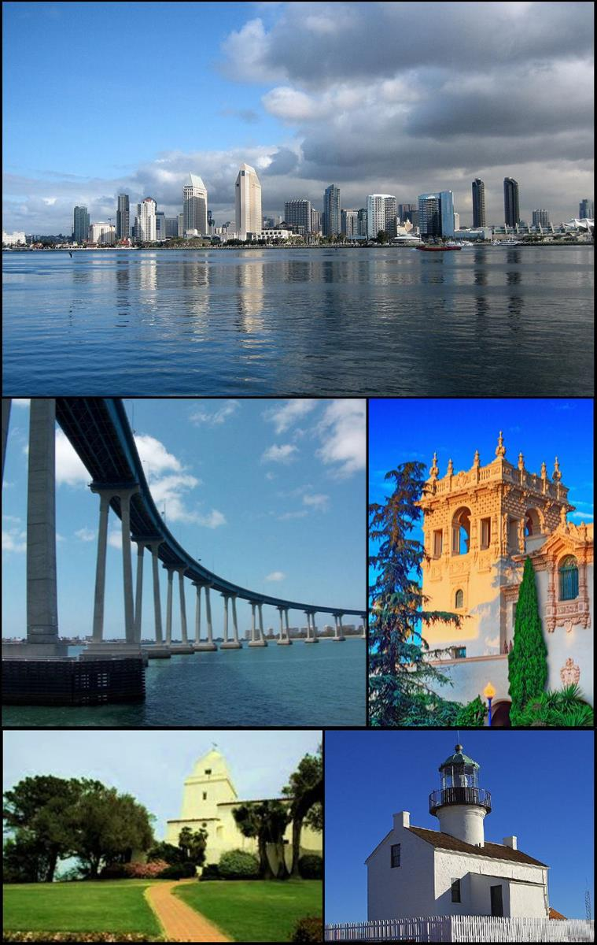
Team Members: Alan Cecil, Garrett Cookson, Brent Giesbrecht, Farhad Omidvar
City Of San Diego 311 Request Analysis

Slide 2
Introduction
Project Description:
In this project we use the 311-call data from the City of San Diego to determine what are the major concerns of residents of San Diego, what zip codes have the most 311 requests, what source was used the most to submit request, if the month, day of the week and temperature affect the number of requests, and determine if there is any relation between the number of 311 calls per population, income bracket.
Hypothesis:
Middle of the week would be more complaint
With higher temperature would be more complaint
With higher income would be more complaint
Number of service requests increase by population

Slide 3
Introduce the data
To gather our Data, we used:
311 call data from City of San Diego
income and population per zip code data form US Census of Bureau.
Historical weather Data from OpenWeatherMap

Slide 4
Data Clean up
Data Cleaning:
Use Pandas to remove unnecessary data from initial .csv file
Use Regex to separate the date data and put it the different columns
Use uszipcode library to retrieve zip code for each latitude Longitude
Removing invalid zip codes
Merging all data frame to get final data frame for analysis and plotting
Challenges:
Finding relevant data from US Census Bureau
Retrieving zip codes with Latitude and Longitude for each service requests
Finding the valid zip code reference for City of San Diego
Combining data from different sources in a correct way

Slide 5
Our analysis strategy
To do our analysis, we used:
Bar Chart
Pie Chart
Scatter Plot
Heatmap
Linear Regression

Slide 6
Contents
San Diego Service Requests
Requests Sources
Calls by day of the Week and Month
Calls by Zip code
Calls and Income Correlation
Calls and Temperature Correlation

Slide 7
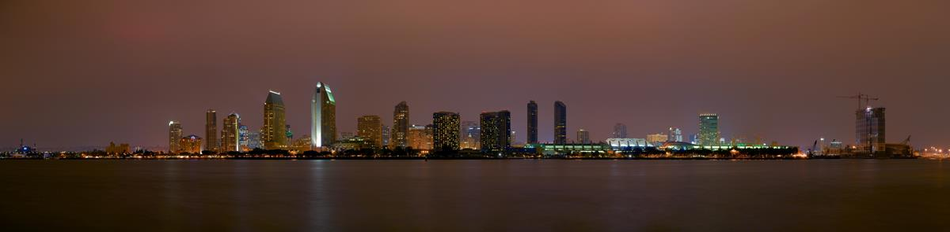
Major Complaint Categories
311 San Diego – Get it Done.
Notes:
Consider talking about:
Communities and neighborhoods
Cityscape
Climate
Ecology

Slide 8
Major concerns of residents of San Diego

Slide 9
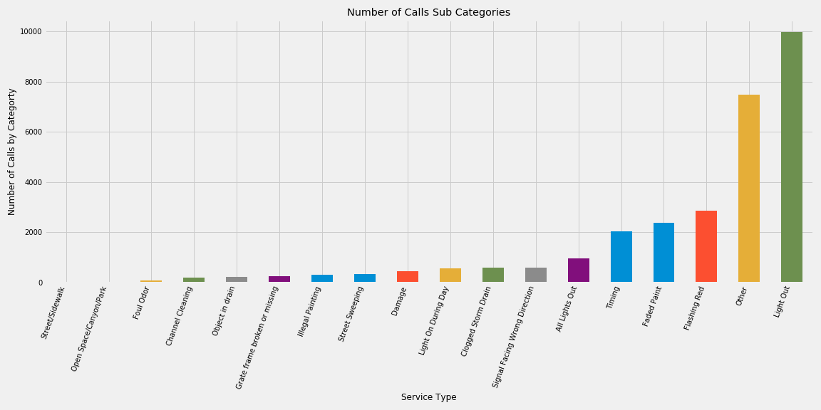
Subtype Categories

Slide 11
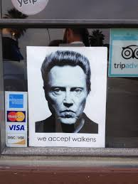
What source or how did people complain?
Walk-ins
Web
Mobile
Letter
In Person
Phone
Crew Generated

Slide 12
Sources was used the most to submit request

Slide 14
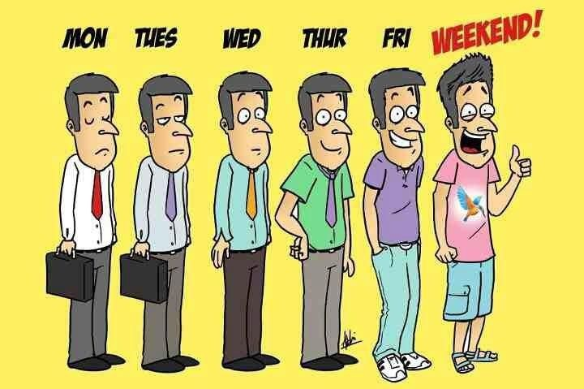
Which day of the week has the most complains?

Slide 17
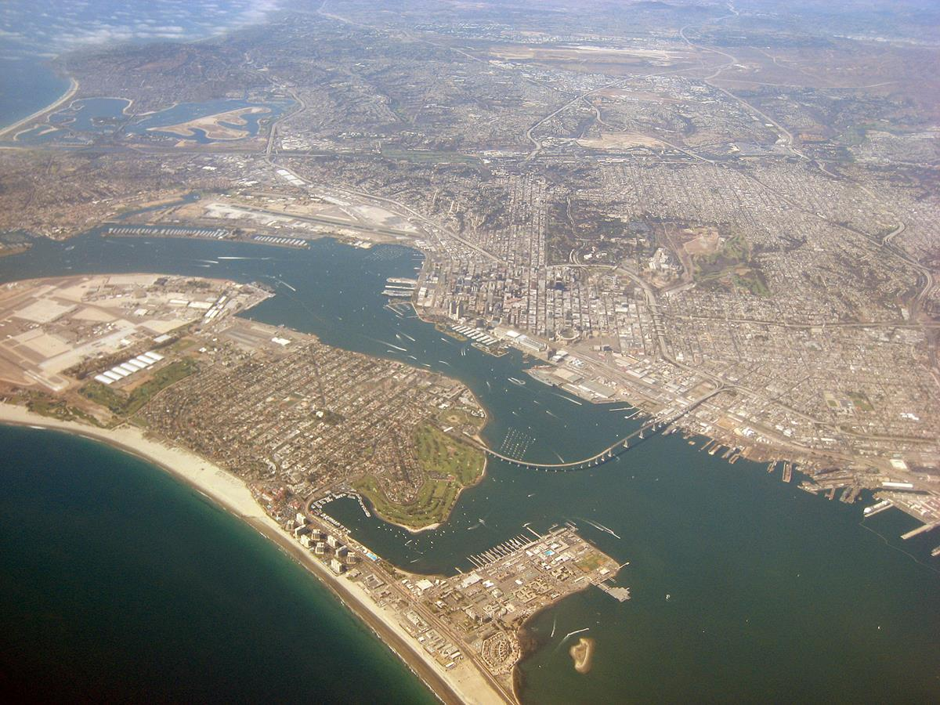
Comparing Complaints by Zip Codes
Complaints by Zip code.
Notes:
Consider talking about:
Utilities
Street lights
Transportation

Slide 18
Found 92101 zip code had the most complaint followed by 92109,92102 and 92115 zip codes

Slide 19
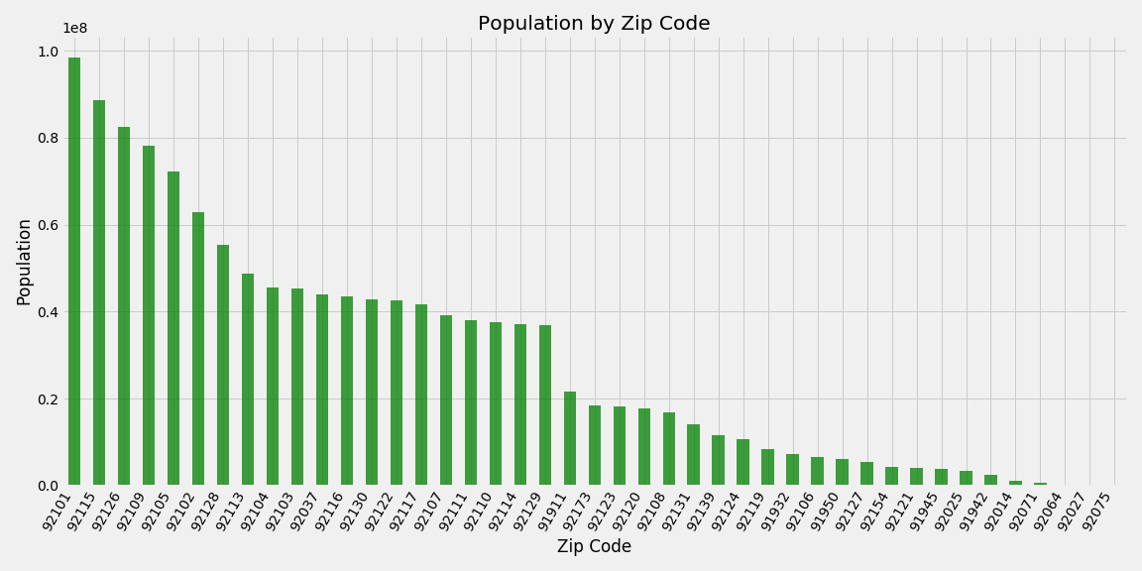
Population for each Zip code

Slide 20
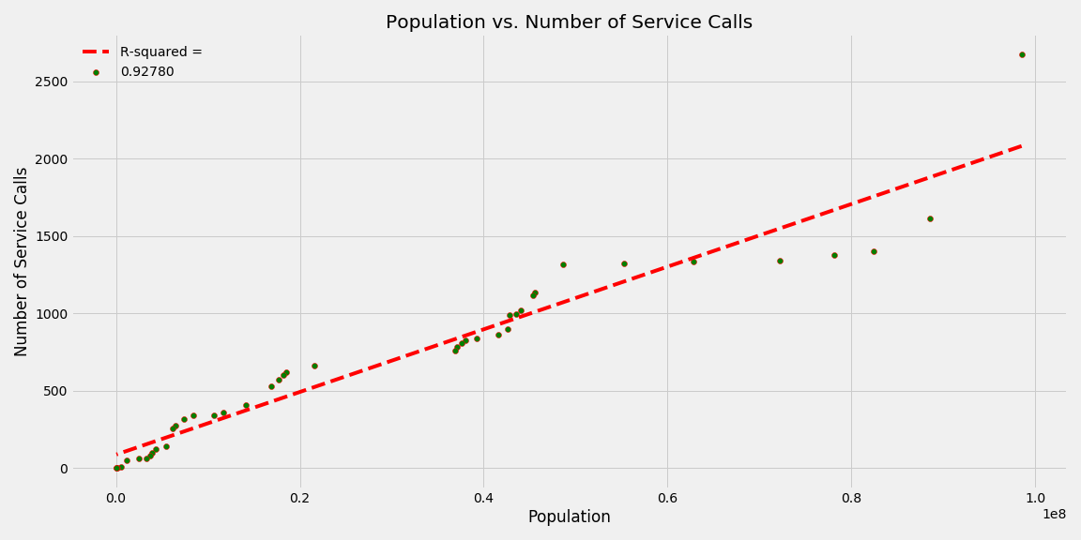
Relation between Number of Requests and Population

Slide 21
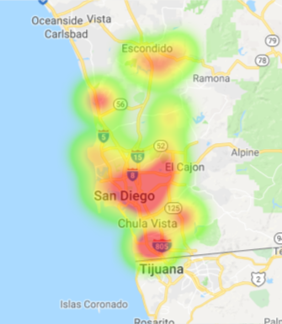
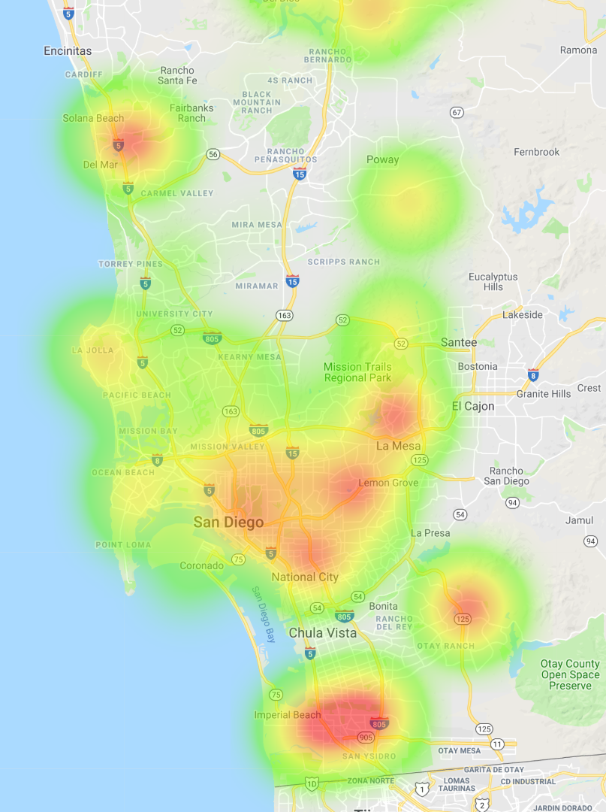
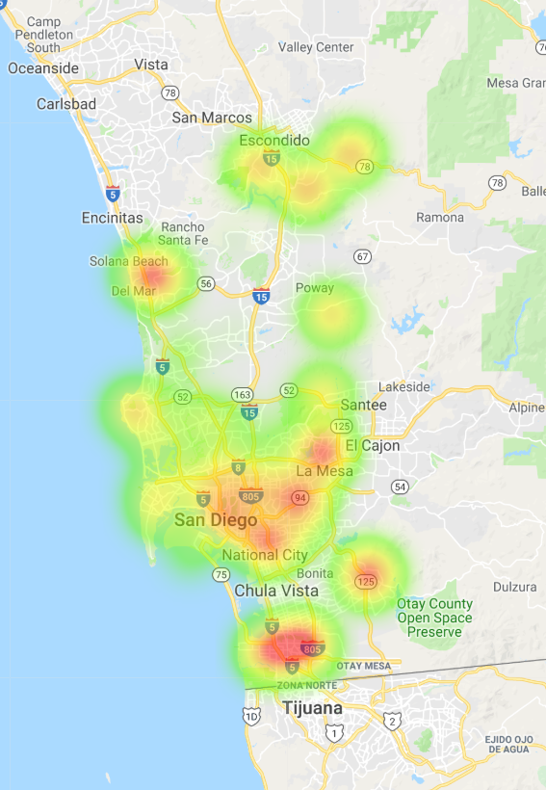
Visual representation of 311 complaints for each zip code as a heat map

Slide 22
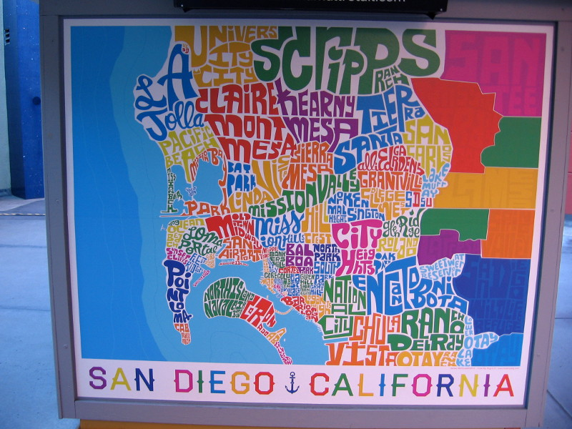
How does number of call compare by income bracket?

Slide 25
In Conclusion
Tuesday is the day with the most calls.
January is the month with the most calls.
The 92101 makes the most calls. Or the area that includes Airport, harbor Island, Main part of Downtown, and Bankers Hill and has the most population.
As we expected the most number of service calls came from the highest populated area
Weather makes no difference to amount of calls.
Highest subtype is a street light is out because most noticeable

Slide 26
Data Sources Used:
City of San Diego
US Census Bureau

Slide 27
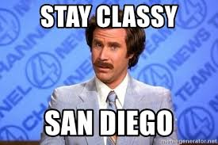
Thank you! And Stay Classy!

